Slide 1
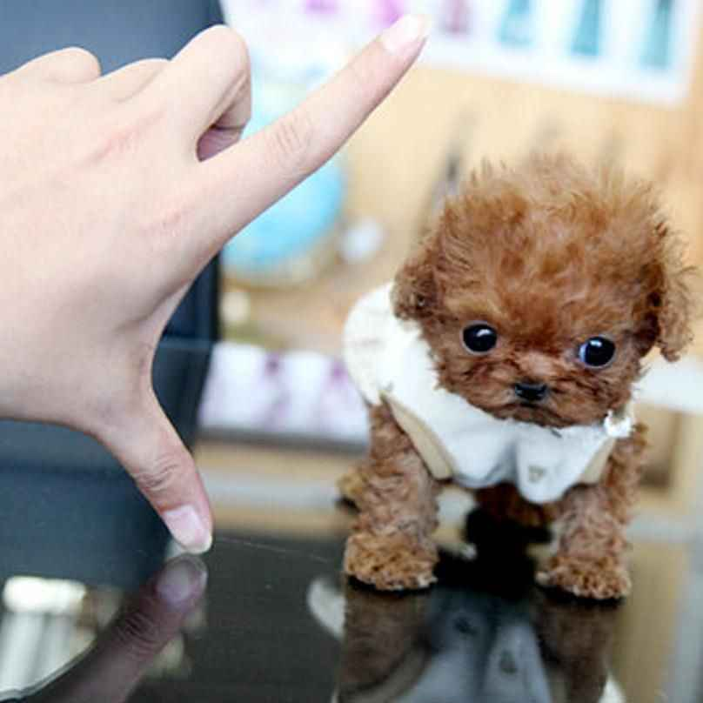

DON’T BURST MY BUBBLE
CREATED BY: (The very cool and awesome)
Team Alpha Wolf

Slide 2

Meet the team!
As the alpha wolf we have to be the best at game
development and be super cool and amazing, am I right? ;)
Our amazing team put in a ton of effort into this silly game in the
past 48 hours, here’s our roles:
Ali: Game developer
Chloe: Game developer, artist, role allocation
Shane: Sound Designer
Morgan: Mechanical Programmer, level designer
Game developers brought our game design to life with the help of coding intricate systems that control the game mechanics and interactions ☺!
Game designers transform ideas into engaging gameplay ideas which ensures a seamless balance of challenge and fun!

Slide 3

Game Concept Overview
Main Idea and Objectives
“Don’t Burst My Bubble” combines stealth mechanics and a quirky adventure as you help a poor tiny bubble reunite with their bubbly family in a world full of dangerous and spikey objects.
Players navigate through levels while avoiding detection from enemies, whom if they catch you, will chase and burst you with their spikes!
You must find the special star to progress through the game
Movement in the game is via WASD
It is up to you to save the baby bubble!

Slide 4
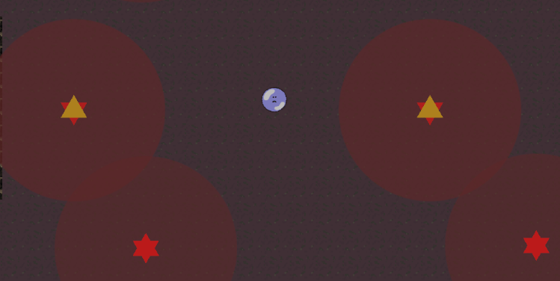
Character dynamics + Gameplay Mechanics
Enemy Type
Enemies will be patrolling around with red lights to show their radius, if you fall into their red radius they will follow you. Be careful, they are very pointy, and may make you go POP!
Main character
Players control a nimble character that cannot be damaged in any way, it moved around with WASD controls and must find the yellow star to proceed to find its family.

Slide 5
Game Level Design
Level Number | What is taught | What is introduced
1 | The absolute basics | Enemies chase the player
2 | The enemies will can move back and forth | Timing your movement
3 | Enemies will greatly increase speed | Need absolute perfect timing
4 | You need to Kite Enemies | Kiting enemies helps you complete the objective
The table to the right summarises the different levels inside of the game and their objectives in “Don’t Burst My Bubble”. Each level is built upon from its last, becoming more interesting and challenging at the same time!

Slide 6
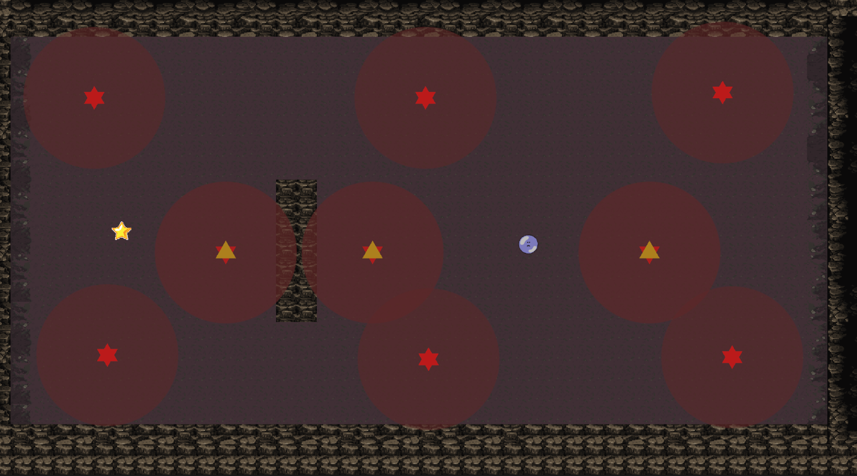
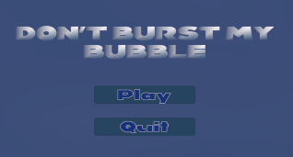
Game Audio and Design
Inside of the game we have implemented the use of audio to increase user friendliness to make the game more fun and interesting!
Game win, game lose, main page and game levels each have their own background music. An immersive soundtrack enhances gameplay, thus matching the game’s stealthy and suspenseful albeit quirky atmosphere. | Art Style inside of the game The unique art design blends animated elements with serious themes, creating an engaging visual experience. | Sound effects Sound cues for environmental interactions and menu button interactions enrich player experience, keeping players interested.

Slide 7
Thank you?!
We hope you will enjoy our game!☺

